Slide 1

Copyright © 2007 by Pearson Education, Inc.
All rights reserved.

Slide 2

CONTENTS
8-1 Using Be: Past Time
8-2 Simple Past Tense of Be: Negative
8-3 Past of Be: Questions
8-4 Simple Past Tense: Using -ed
8-5 Past Time Words: Yesterday, Last, and Ago
8-6 Simple Past Tense: Irregular Verbs (Group 1)
8-7 Simple Past Tense: Negative
8-8 Simple Past Tense: Yes/No Questions
8-9 Simple Past Tense: Irregular Verbs (Group 2)
8-10 Simple Past Tense: Irregular Verbs (Group 3)
8-11 Simple Past Tense: Irregular Verbs (Group 4)

Slide 3
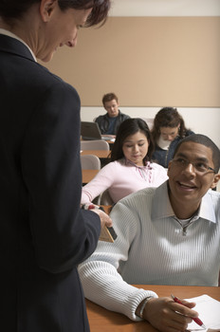
8-1 USING BE: PAST TIME
I am in class today.
I was in class yesterday.

Slide 4
8-1 USING BE: PAST TIME
PRESENT TIME
PAST TIME
(a) I am in class today.
(b) I was in class yesterday.
(c) Jun is here today.
(d) Jun was here yesterday.
(e) We are happy today.
(f) We were happy yesterday.

Slide 5
8-1 USING BE: PAST TIME
SIMPLE PAST TENSE OF BE
Singular
Plural
I was
we were
you were
you were
she was
he was
it was
they were

Slide 6
8-1 USING BE: PAST TIME
SIMPLE PAST TENSE OF BE
I
she
he
it
we
you
they
+ were
+ was

Slide 7
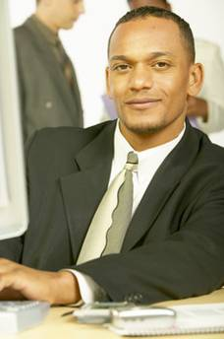
8-1 Let’s Practice
be
present
past
at work
was
yesterday.
I ____
am
today.

Slide 8
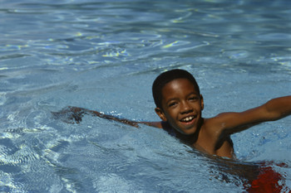
8-1 Let’s Practice
be
present
past
He ___
was
is
in the pool
last week.
today.

Slide 9
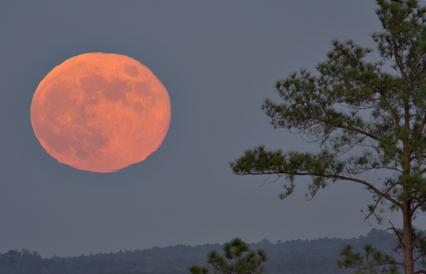
8-1 Let’s Practice
be
present
past
The moon ____ huge
was
is
tonight.
last night.

Slide 10
8-1 Let’s Practice
Directions for the teacher:
The next slide contains questions that can
be answered by typing on the screen. The grey boxes accept data entry. Click on them, in any order, to answer the questions. Anything typed in the boxes will not be saved unless you purposefully save the file.
Of course, you can have students answer orally and not display their answer.

Slide 11
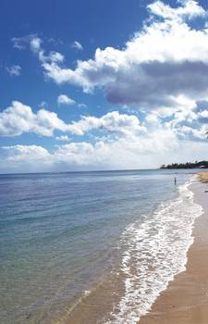
8-1 Let’s Practice
present
The water is warm today.
past
(click and type)

Slide 12
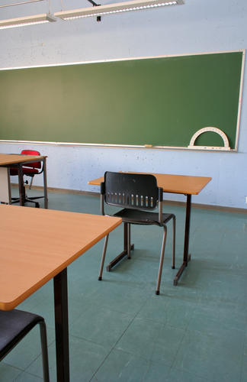
8-2 SIMPLE PAST TENSE OF BE: NEGATIVE
I was not in class yesterday.

Slide 13
8-2 SIMPLE PAST TENSE OF BE: NEGATIVE
(a) I was not in class yesterday.
(b) She wasn’t in class yesterday.
was + not = wasn’t
I
she
he
it
+ wasn’t

Slide 14
8-2 SIMPLE PAST TENSE OF BE: NEGATIVE
(c) You were not home last night.
(d) You weren’t home last night.
were + not = weren’t
we
you
they
+ weren’t

Slide 15
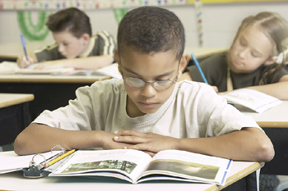
8-2 Let’s Practice
Jared is in class this morning, but
________ in class yesterday morning.
he wasn’t

Slide 16
8-2 Let’s Practice
They are in London tonight, but
___________ in London last night.
they weren’t

Slide 17
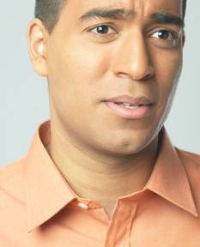

8-2 Let’s Practice
I am happy today, but
I wasn’t happy
____________ yesterday.

Slide 18
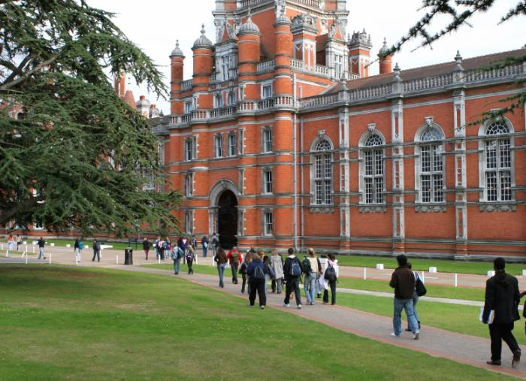
8-2 Let’s Practice
The weather is nice this week, but
___________ last week.
it wasn’t nice

Slide 19

8-3 PAST OF BE: QUESTIONS
Were you in class yesterday?

Slide 20
8-3 PAST OF BE: QUESTIONS
YES/NO QUESTIONS
SHORT ANSWER
+ LONG ANSWER
(a) Were you in class yesterday?
(be) + (subject)
Yes, we were.
We were in class yesterday.

Slide 21
8-3 PAST OF BE: QUESTIONS
YES/NO QUESTIONS
SHORT ANSWER
+ LONG ANSWER
(a) Were you in class yesterday?
(be) + (subject)
No, we weren’t.
We weren’t in class yesterday.

Slide 22
8-3 PAST OF BE: QUESTIONS
YES/NO QUESTIONS
SHORT ANSWER
+ LONG ANSWER
(b) Was Jean at the library last week?
(be) + (subject)
Yes, she was.
She was at the library last week.

Slide 23
8-3 PAST OF BE: QUESTIONS
YES/NO QUESTIONS
SHORT ANSWER
+ LONG ANSWER
(b) Was Jean at the library last week?
(be) + (subject)
No, she wasn’t.
She wasn’t at the library last week.

Slide 24
8-3 PAST OF BE: QUESTIONS
INFORMATION QUESTIONS
SHORT ANSWER
+ LONG ANSWER
(c) Where was Bill last winter?
Where + (be) + (subject)
In Mexico.
He was in Mexico last winter.

Slide 25
8-3 PAST OF BE: QUESTIONS
INFORMATION QUESTIONS
SHORT ANSWER
+ LONG ANSWER
(d) Where were they last month?
Where + (be) + (subject)
On vacation.
They were on vacation last month.

Slide 26
8-3 Let’s Practice
_____ Andrea in class on Friday?
Was
No,
she wasn’t.
She
wasn’t in class on Friday.

Slide 27
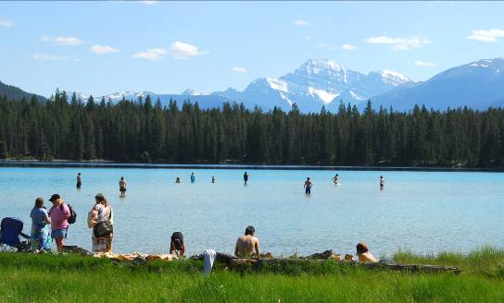
8-3 Let’s Practice
_____ you and Simi at the lake last week?
Were
Yes, .
we were
We were at the lake last week.

Slide 28
8-3 Let’s Practice
_____ Nina with you last week?
Was
No, .
She wasn’t with me.
she wasn’t

Slide 29
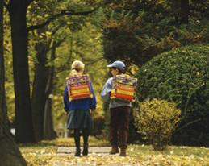
8-4 SIMPLE PAST TENSE: USING -ED
We walked to school.

Slide 30
8-4 SIMPLE PAST TENSE: USING -ED
SIMPLE PRESENT
(a) We walk to school every day.
SIMPLE PAST
(b) We walked to school yesterday.

Slide 31
8-4 SIMPLE PAST TENSE: USING -ED
SIMPLE PRESENT
(c) Hakim walks to school every day.
SIMPLE PAST
(d) Hakim walked to school yesterday.

Slide 32
8-4 SIMPLE PAST TENSE: USING -ED
verb + -ed = the simple past
I
you
she
he
it
we
they
+ walked (verb + -ed)

Slide 33
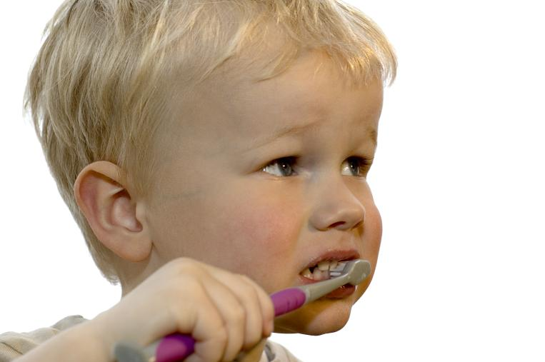
8-4 Let’s Practice
Every day I brush my teeth.
Yesterday _______________.
I brushed my teeth

Slide 34
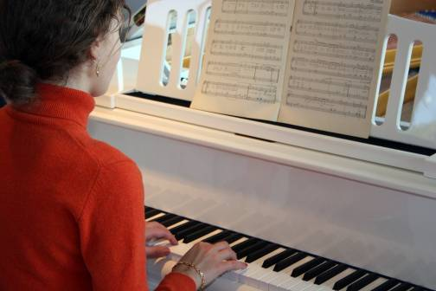
8-4 Let’s Practice
Every day Julie plays the piano.
Yesterday she _____________.
played the piano

Slide 35
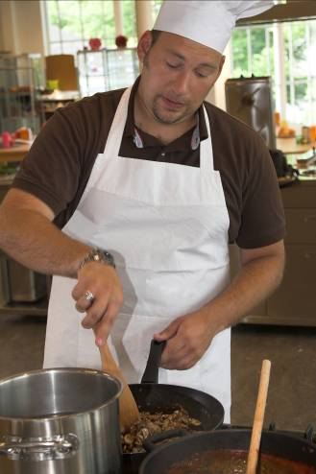
8-4 Let’s Practice
Every day Edgar cooks.
Yesterday _________.
he cooked

Slide 36
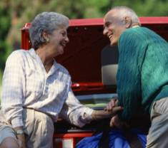
8-5 PAST TIME WORDS: YESTERDAY, LAST, AND AGO
Bob and Helen were here yesterday.

Slide 37
8-5 PAST TIME WORDS: YESTERDAY, LAST, AND AGO
YESTERDAY
yesterday.
yesterday morning.
yesterday afternoon.
yesterday evening.
(a) Bob was here ...

Slide 38
8-5 PAST TIME WORDS: YESTERDAY, LAST, AND AGO
last night. last week. last month. last year.
last spring. last summer.
last Monday. last Friday.
LAST
(b) Eve was here ...

Slide 39
8-5 PAST TIME WORDS: YESTERDAY, LAST, AND AGO
AGO
five minutes ago.
two hours ago.
six days ago.
a month ago.
a year ago.
ten years ago.
(c) Omar was here …

Slide 40
8-5 PAST TIME WORDS: YESTERDAY, LAST, AND AGO
morning
afternoon
evening
yesterday with

Slide 41
8-5 PAST TIME WORDS: YESTERDAY, LAST, AND AGO
night
long periods of time
seasons
days of the week
last with

Slide 42
8-5 PAST TIME WORDS: YESTERDAY, LAST, AND AGO
length of time
five minutes
two hours
six days
a month
five months
one year
ten years
+ ago
(in the past)

Slide 43
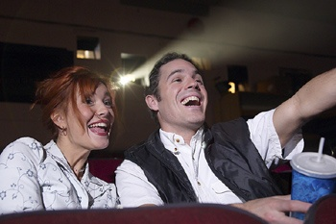
8-5 Let’s Practice
yesterday last
We went to the movies ________ afternoon.
yesterday

Slide 44
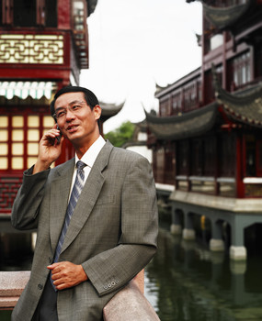
8-5 Let’s Practice
I called you ________ week.
last
yesterday
last

Slide 45
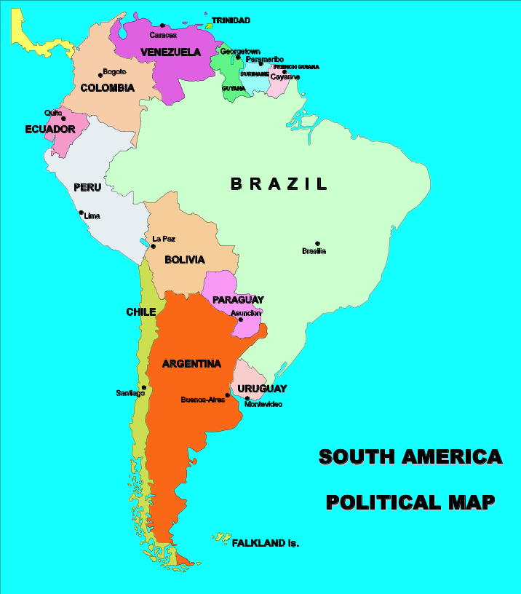
8-5 Let’s Practice
Janice left for South America
________ morning.
yesterday
yesterday
last

Slide 46
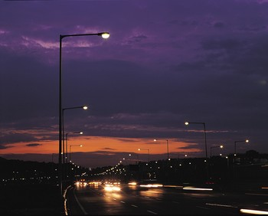
8-5 Let’s Practice
The sky was beautiful ______ night.
last
yesterday
last

Slide 47
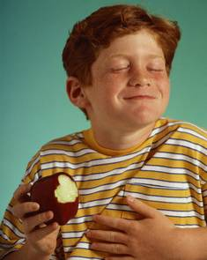
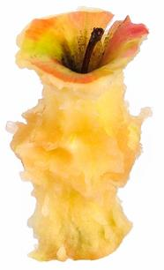
8-6 SIMPLE PAST TENSE: IRREGULAR VERBS (GROUP 1)
eat
ate

Slide 48
8-6 SIMPLE PAST TENSE: IRREGULAR VERBS (GROUP 1)
PRESENT PAST
come came
I come home
every afternoon.
I came home
this afternoon.

Slide 49
8-6 SIMPLE PAST TENSE: IRREGULAR VERBS (GROUP 1)
PRESENT PAST
go went
I went swimming
last Tuesday.
I go swimming
every Tuesday.

Slide 50
8-6 SIMPLE PAST TENSE: IRREGULAR VERBS (GROUP 1)
PRESENT PAST
write wrote
I wrote a letter
to her last week.
I write a letter to
my grandmother
every week.

Slide 51
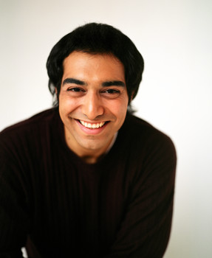
8-6 Let’s Practice
I have ice cream every Sunday. I had ice cream last Sunday.

Slide 52
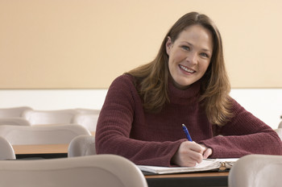
8-6 Let’s Practice
What did I do last
Sunday?
have
had
had
You ___
ice cream.

Slide 53

8-6 Let’s Practice
She sits at her desk to study every night. She sat at her desk last night.

Slide 54
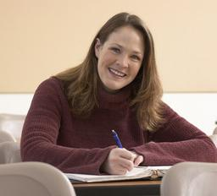
8-6 Let’s Practice
What did she do last night?
She ___ at her desk.
sit
sat
sat

Slide 55
8-6 Let’s Practice
She sees her best friend every weekend. She saw her last weekend.

Slide 56
8-6 Let’s Practice
What did she do last weekend?
She ____ her
best friend.
saw
see
saw

Slide 57
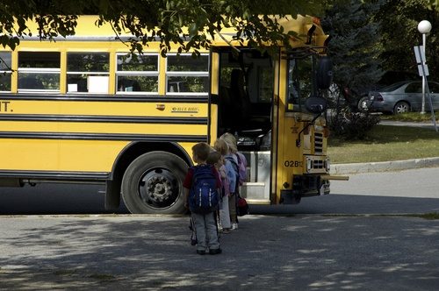
8-7 SIMPLE PAST TENSE: NEGATIVE
I did not walk to school yesterday.

Slide 58
8-7 SIMPLE PAST TENSE: NEGATIVE
SUBJECT + DID + NOT + MAIN VERB
(a) I did not drive to work yesterday.
(b) You did not drive to work yesterday.
(c) Mike did not cook dinner yesterday.
(d) They did not drive to work yesterday.

Slide 59
8-7 SIMPLE PAST TENSE: NEGATIVE
I
you
she
he
it
we
they
+ did not + main verb

Slide 60
8-7 SIMPLE PAST TENSE: NEGATIVE
(e) I didn’t watch a movie last night.
(f) Ade didn’t play soccer yesterday.
NEGATIVE CONTRACTION
did + not = didn’t

Slide 61
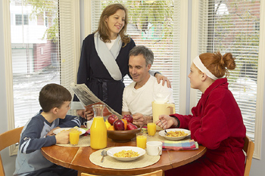
8-7 Let’s Practice
We don’t eat breakfast every day.
We ate breakfast Monday, but we ________ breakfast Tuesday.
didn’t eat

Slide 62
8-7 Let’s Practice
I don’t sleep well every night. I slept
well last night, but I __________ well
on Thursday night.
didn’t sleep

Slide 63
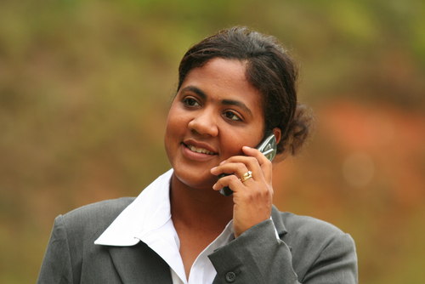
8-8 SIMPLE PAST TENSE: YES/NO QUESTIONS
Did Laurie walk to work?

Slide 64
8-8 SIMPLE PAST TENSE: YES/NO QUESTIONS
DID + SUBJECT + MAIN VERB
(a) Did Laurie walk to work?
Yes, she did.
She walked to work.

Slide 65
8-8 SIMPLE PAST TENSE: YES/NO QUESTIONS
DID + SUBJECT + MAIN VERB
(a) Did Laurie walk to school?
No, she didn’t.
She didn’t walk to school.

Slide 66
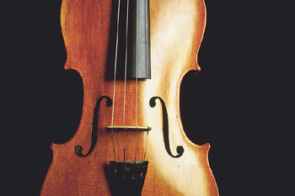
8-8 SIMPLE PAST TENSE: YES/NO QUESTIONS
DID + SUBJECT + MAIN VERB
(b) Did you practice the violin?
Yes, I did.
I practiced the violin.

Slide 67
8-8 SIMPLE PAST TENSE: YES/NO QUESTIONS
DID + SUBJECT + MAIN VERB
(b) Did you practice the violin?
No, I didn’t.
I didn’t practice the violin.

Slide 68
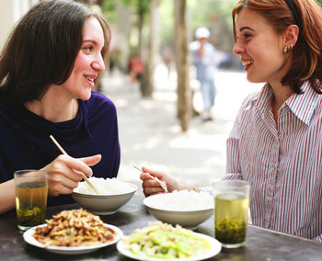
8-8 Let’s Practice
Did you see your dad today?
Yes, I did.
I saw my
dad today
_________________.

Slide 69
8-8 Let’s Practice
Did you see your brother today
Yes, I did.
I saw my
brother today.
_________________________?

Slide 70
8-8 Let’s Practice
did you
do last night
_____________________?
What
We went to a party last night.

Slide 71
8-8 Let’s Practice
Did Andrea go
on vacation
Yes, she did. Andrea went on
vacation.
_____________________?

Slide 72

8-9 SIMPLE PAST TENSE: IRREGULAR VERBS (GROUP 2)
bring
brought

Slide 73
8-9 SIMPLE PAST TENSE: IRREGULAR VERBS (GROUP 2)
PRESENT PAST
bring brought
I always bring
gifts to birthday
parties.
I brought a gift
to your party
yesterday.

Slide 74
8-9 SIMPLE PAST TENSE: IRREGULAR VERBS (GROUP 2)
PRESENT PAST
drive drove
She drives to
school.
She drove to
school today.

Slide 75
8-9 SIMPLE PAST TENSE: IRREGULAR VERBS (GROUP 2)
PRESENT PAST
run ran
He runs to
school.
He ran to school
this morning.

Slide 76
8-9 SIMPLE PAST TENSE: IRREGULAR VERBS (GROUP 2)
PRESENT PAST
buy bought
catch caught
drink drank
read read
ride rode
shut shut
teach taught
think thought

Slide 77
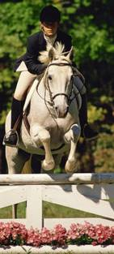
8-9 Let’s Practice
I ____ my horse every Sunday I ____ him last Sunday.
ride
rode
ride
rode

Slide 78

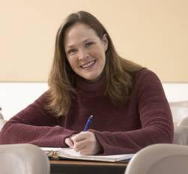
8-9 Let’s Practice
What did I do last Sunday?
You rode your
horse
_______________________.
ride
rode

Slide 79
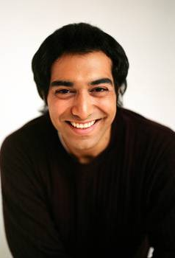
8-9 Let’s Practice
I _____ a class every Monday night. I ______ a class last Monday night.
teach
taught
teach
taught

Slide 80
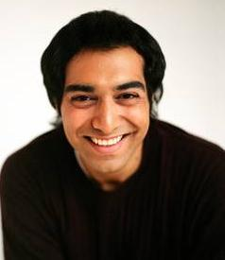
8-9 Let’s Practice
What did I do last Monday?
You taught a
class
_________________.
teach
taught

Slide 81
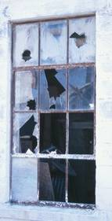
8-10 SIMPLE PAST TENSE: IRREGULAR VERBS (GROUP 3)
Someone broke the window.

Slide 82
8-10 SIMPLE PAST TENSE: IRREGULAR VERBS (GROUP 3)
PRESENT PAST
break broke
That child breaks
everything.
She broke my
coffee cup.

Slide 83
8-10 SIMPLE PAST TENSE: IRREGULAR VERBS (GROUP 3)
PRESENT PAST
meet met
I can meet you
after school.
They met in their
English class.

Slide 84
8-10 SIMPLE PAST TENSE: IRREGULAR VERBS (GROUP 3)
PRESENT PAST
sing sang
I like to sing
new songs.
I sang a new song
last night.

Slide 85
8-10 SIMPLE PAST TENSE: IRREGULAR VERBS (GROUP 3)
PRESENT PAST
wake up woke up
Sometimes I wake
up very early.
Today I woke
up late.

Slide 86
8-10 SIMPLE PAST TENSE: IRREGULAR VERBS (GROUP 3)
PRESENT PAST
fly flew
hear heard
leave left
pay paid
ring rang
send sent
speak spoke
take took

Slide 87
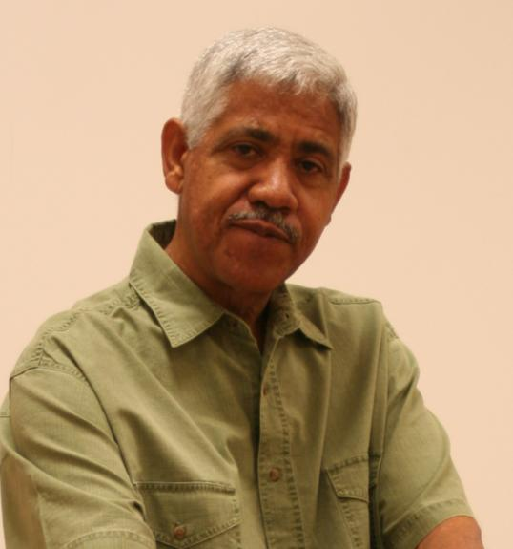
8-10 Let’s Practice
I _____ email every day. I _____ email today.
send
sent
send
sent

Slide 88

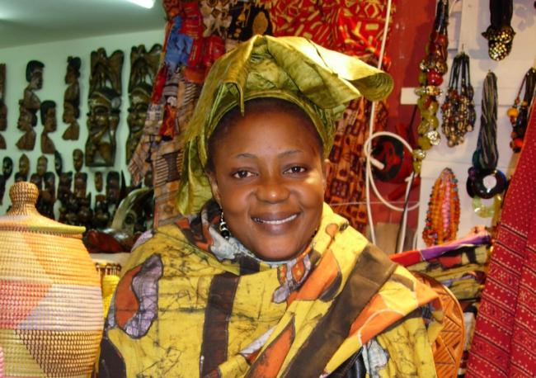
8-10 Let’s Practice
What did I
do today?
send
sent
You sent email
_____________.

Slide 89
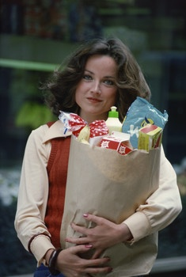
8-10 Let’s Practice
I ____ in my car every day. Yesterday I ____ a new song.
sing
sang
sing
sang

Slide 90

8-10 Let’s Practice
What did I
do yesterday?
sing
sang
You sang a new song
_________________.

Slide 91
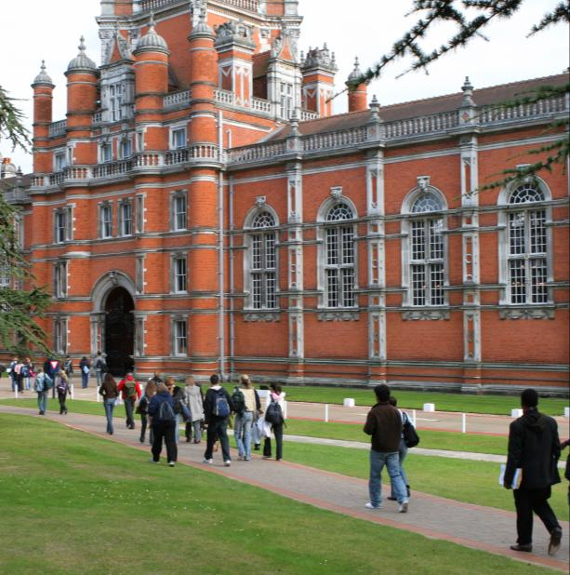
8-11 SIMPLE PAST TENSE: IRREGULAR VERBS (GROUP 4)
begin
began

Slide 92
8-11 SIMPLE PAST TENSE: IRREGULAR VERBS (GROUP 4)
PRESENT PAST
begin began
She began college
at age 25.
People usually
begin college at
age 18.

Slide 93
8-11 SIMPLE PAST TENSE: IRREGULAR VERBS (GROUP 4)
PRESENT PAST
wear wore
I wear a uniform
at my new job.
I wore regular
clothes at my
old job.

Slide 94
8-11 SIMPLE PAST TENSE: IRREGULAR VERBS (GROUP 4)
PRESENT PAST
find found
lose lost
hang hung
say said
sell sold
steal stole
tell told
tear tore

Slide 95
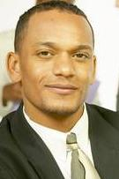
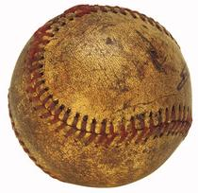
8-11 Let’s Practice
I like to ____ things I don’t use any more. Yesterday I ____ my old baseball.
sell
sold
sell
sold

Slide 96
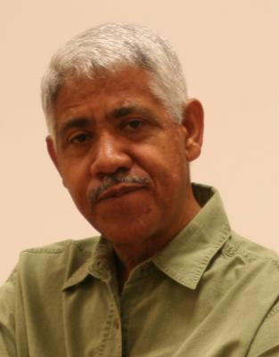
8-11 Let’s Practice
What did I do yesterday?
_____________________.
You sold your
old baseball
sell
sold

Slide 97

8-11 Let’s Practice
I always _____ my tools on my garage wall. Last weekend I _____ the rake on the garage wall.
hang
hung
hang
hung

Slide 98

8-11 Let’s Practice
What did I do yesterday?
hang
hung
You hung your rake on the garage wall
___________________________________.

Slide 99
PHOTO CREDITS
Images used under license from:
Shutterstock, Inc.
Clipart.com

